Slide 1
Review of the OECD AI Principles Communications toolkit 3 May 2024

Slide 2
Context
The OECD Principles on Artificial Intelligence (AI) are the first intergovernmental standard on AI.
They guide policymakers and AI actors to design, develop and deploy innovative, trustworthy AI that upholds human rights and democratic values.
In response to recent developments in AI technologies, OECD and partner countries revised the Principles to more directly address challenges involving privacy, intellectual property rights, safety, and information integrity.
With 46 adhering countries, the OECD AI Principles provide a blueprint for policy frameworks on how to address AI risks and shape AI policies.

Slide 3
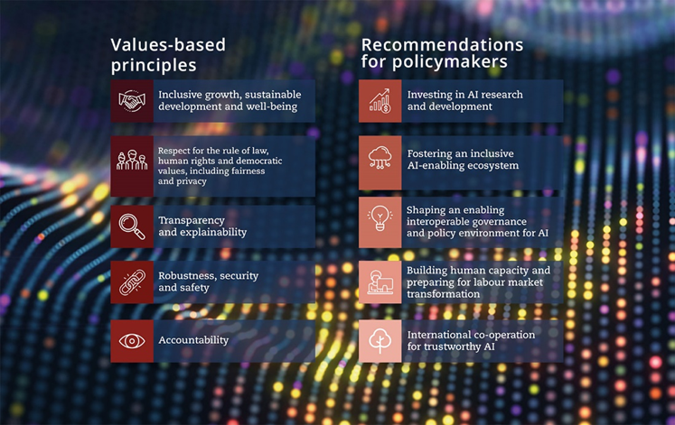
The OECD Principles on Artificial Intelligence

Slide 4
Revisions to the OECD AI Principles
The following revisions will ensure that the Principles remain relevant, robust and fit-for-purpose:
Addressing safety concerns, so that if AI systems risk causing undue harm or exhibit undesired behaviour, robust mechanisms and safeguards exist to override, repair, and/or decommission them safely.
Reflecting the growing importance of addressing mis- and disinformation, and safeguarding information integrity in the context of generative AI.
Emphasising responsible business conduct throughout the AI system lifecycle, involving co-operation with suppliers of AI knowledge and AI resources, AI system users, and other stakeholders.
Clarifying the information regarding AI systems that constitute transparency and responsible disclosure.
Explicitly referencing environmental sustainability, a concern that has grown considerably in importance over the past five years.
Underscoring the need for jurisdictions to work together to promote interoperable governance and policy environments for AI, as the number of AI policy initiatives worldwide surges.

Slide 5
Communication plan – Public release on 3 May 2024
The OECD Ministerial Council Meeting (MCM) will adopt revisions to the landmark OECD Principles on Artificial Intelligence on 3 May 2024 TIME?.
The OECD Media Office will issue a press release on the same day, which will be published in the OECD Newsroom.
An OECD social media campaign will also be launched. The following slides propose sample social media posts for adhering countries wishing to communicate about the Principles.

Slide 6
Sample social media post 1
Under embargo until 3 May 2024 TIME
Together with fellow OECD and partner countries, COUNTRY NAME reaffirms its commitment to #OECDAI Principles and welcomes its update to stay abreast of rapid technological and policy developments.
The revisions address concerns including safety, dis-information, the environment and regulatory interoperability. They respond to recent developments in AI and the rapidly evolving risks associated with newer technologies such as general-purpose and generative AI.
Visit OECD.AI to find out more 👉 oecd.ai/ai-principles
Download visual here

Slide 7
Sample social media post 2
Under embargo until 3 May 2024 TIME
COUNTRY NAME supports the revised #OECDAI Principles in response to recent developments in AI technologies, notably the rise of general-purpose and #GenAI.
We welcome their general scope which ensures applicability to AI developments around the world.
COUNTRY NAME reaffirms its commitment to the #OECDAI Principles which advocate for AI that is innovative and trustworthy, and that upholds human rights and democratic values.
Visit OECD.AI to find out more 👉 oecd.ai/ai-principles
Download visual here

Slide 8
Useful links
@OECDInnovation @OECD
@OCDE_fr
OECD-AI
OECD [EN]
OCDE [FR]
OECD [EN]
OCDE [FR]
Social media visual
OECD AI Principles
Press release
#
#OECDAI
ai@oecd.org

